Slide 1
Capstone Project

Slide 2
Data Acquisition and Cleaning
The Coursera-SwiftKey.zip, consisting of three files, was downloaded from the Coursera page:
 | Size | Lines
en_US.blogs.txt | 200 MB | 899,288
en_US.news.txt | 196 MB | 1,010,242
en_US.twitter.txt | 159 MB | 2,360,148

Slide 3
Prediction Algorithm
Tokenization
Prepare unigram, bigram and trigram from the data
Count the occurrences of each unique unigram, bigram and trigram
Get the text phrase from the user
Extract the last two tokens (e.g. prev1, prev2) from the phrase. If the phrase is not long enough, extract the last token (i.e. prev2)
Calculate the probability of the possible match
Return the top 5 predicted words

Slide 4
Clean and tokenize the user input text
N-grams derived from a training text corpus along
with a “back-off” strategy are utilized to predict the new word based on the user input.
Return the predicted word(s) up to the maximum number (5)
of predicted words.

Slide 5
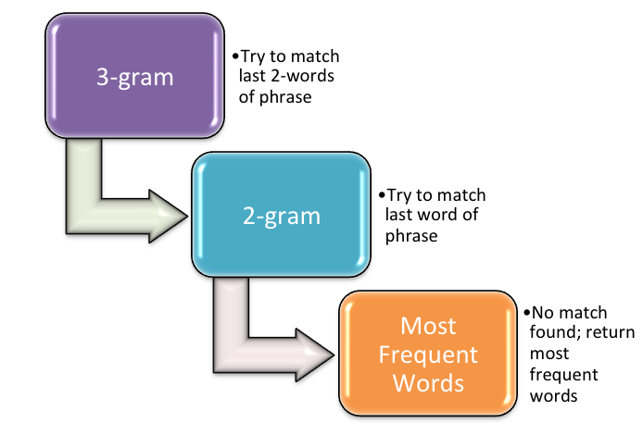

Slide 6
Calculating the Probability
To take the diversity of histories into account, I adopted Modified Kneser-Ney Smoothing for calculating the probability.
Check if there is any match in Trigram (i.e. prev1, prev2 -> matchWord). If cannot find any match, move to step 3.
Return the top 10 predicted word by using the calculated probability. Done!
[Back-off] Check if there is any match in Bigram (i.e. prev2 -> matchWord). If cannot find any match, move to step 5.
Return the top 10 predicted word by using the calculated probability. Done!
[Back-off] Return the top 10 most frequently used Unigram. Done!

Slide 7
Usage of the application
Input phrase in the text field
Press the Submit button
Processing …
The top 10 next prediction words will be listed on the right hand side

